Slide 1
All you need to know to start Security Automation
Lech Lachowicz
Członek Zarządu ds. Profesjonalnego Rozwoju ISSA Polska
Warszawa, 28-02-2021r.

Slide 2

Disclaimer
Who am I:
IT Security specialist with decent background in dev
Global Threat Defense lead responsible for detections, hunting, automation and breach simulation
Big fan of opensource and automation
Who I’m not:
NOT a full time Developer
NOT A DEVOPS
What is it going to be about:
Better and faster SECURITY

Slide 3

Current security operations challenges
Increasing volume and complexity of attacks
67%
of organizations say volume of attacks is increasing
Expanding compliance and obligations
72 hours
to comply with mandatory breach reporting for GPR
Challenging operational environments
26 or more
security products managed on average by organizations

Slide 4
Security Operations need to
Minimize duration and impact of cyber attacks
Optimize SecOps and reduce staff burnout
Address breach reporting requirements and show compliance
Maximize security investments and scale insights across teams
So we automate

Slide 5
Step 0 – Pick the tool
Alerts
Automatic/ Manual Response and Remediation
App Logs
SIEM
Create Helpdesk Ticket
Gather Forensics
Use a tool thats closest to your ecosystem
If the tool can be part of your ticketing system – its the right one
Make sure you have the talent to maintain the tool – you’ll need Python, Javascript, Ruby or something else
Be prepared to scale!
F/W Logs
SOAR
Workflow
Automation
Case Management
Collaboration
Disable Account
DHCP Logs
Endpoint Activity
Threat data
Related Logs
Manually invoked enrichment
Automatic enrichment
Vulnerability Management
Web gateway
VirusTotal

Slide 6

Step 1 – build the measure
Exposed to Threats
Resilient to Threats
Months
MEAN-TIME-TO-DETECT (MTTD) The average time it takes to recognize a threat requiring further analysis and response efforts
MEAN-TIME-TO-RESPOND (MTTR)
The average time it takes to respond and ultimately resolve the incident
Weeks
Days
MTTD & MTTR
Hours
Minutes
As organizations improve their ability to quickly detect and respond to threats, the risk of experiencing a damaging breach is greatly reduced
High Vulnerability
Low Vulnerability

Slide 7
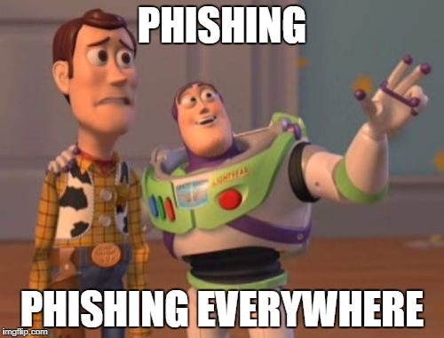
Step 2 – Pick the process
# | Action | Current manual time spent (sec) | Current manual time spent - Explanation
A | Have a look at the email content | 30 | Need to download the email, open it and save a screenshot
B | Collect email header | 60 | Need to grab the email header then run it through a parsing script/tool and finally attach the data to the ticket
C | Check URL & determination | 300 | Need to manually check it against VT/OSINT, test it within SafeBrowser and determine if bad. Finally document it as IOC.
D | Check attachment & determination | 300 | Need to grab the sample, detonate it manually in Sandbox, create IOC and attach the report into Incident
E | Check downloaded malware & determination | 300 | Need to grab the sample, detonate it manually in Sandbox, create IOC and attach the report into Incident

Slide 8

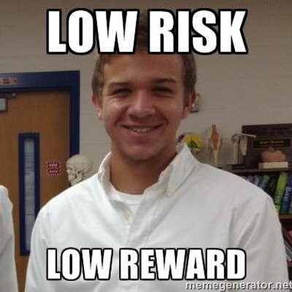

Step 3 – Pick the strategy

Slide 9
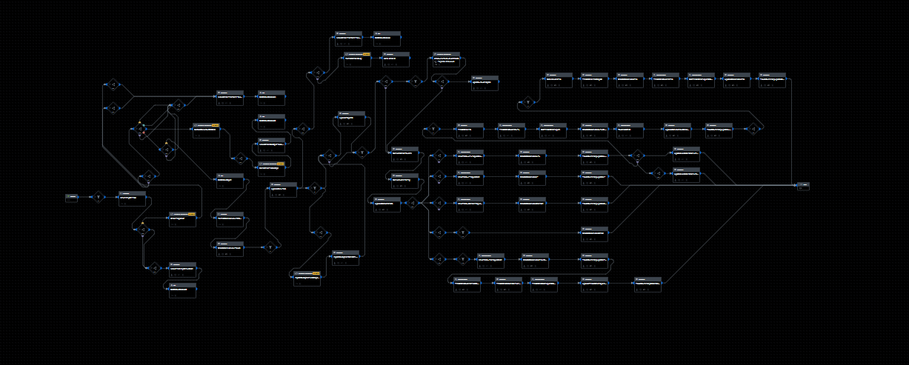


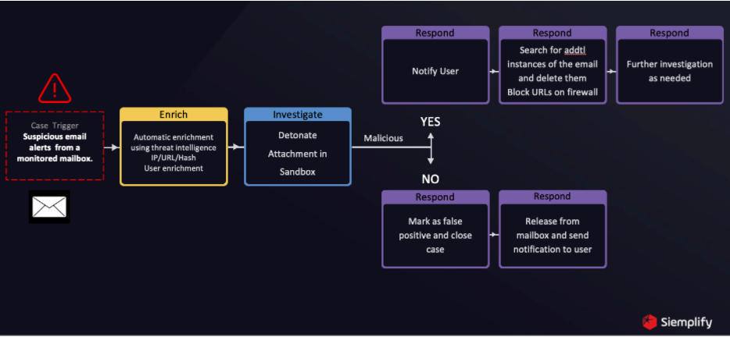
Step 4 – Develop the playbook
Keep it simple
Reuse code
Build testing scenarios
monster playbooks look cool but are hard to maintain
Make the playbooks modular
Break into smaller pieces
Do not modify built-in code… unless there’s no other choice
this is a MUST, period.
And test error handlers

Slide 10
Step 5 – Measure the results
# | Action | Current manual time spent (sec) | Current manual time spent - Explanation
A | Have a look at the email content | 30 | Need to download the email, open it and save a screenshot
B | Collect email header | 60 | Need to grab the email header then run it through a parsing script/tool and finally attach the data into the ticket
C | Check URL & determination | 300 | Need to manually check it against VT/OSINT, test it within SafeBrowser and determine if bad. Finally document it as IOC.
D | Check attachment & determination | 300 | Need to grab the sample, detonate it manually in Sandbox, create IOC and attach the report into Incident
E | Check downloaded malware & determination | 300 | Need to grab the sample, detonate it manually in Sandbox, create IOC and attach the report into Incident
New manual time spent (sec) | New manual time spent - Explanation | Manual time saved (sec)
5 | Screenshot already present in the Incident | 25
5 | Header already displayed in the Incident, with quick spoof check for determination | 55
120 | OSINT is automatically gathered, and IOCs created. URL is detonated in Sandbox. Use Sandbox score and OSINT for determination. | 180
60 | IOC already created with Sandbox report, for quick determination | 240
60 | IOC already created with Sandbox report, for quick determination | 240
Thats 990sec vs 250sec = ~4 times better

Slide 11
The benefits
Reliable
Operate 365 days a year!
Retention
Freed up human resources for higher value-added tasks
Productivity
Accelerate detection and response
Consistent
Eliminating variations in processes
ROI
There are going to be savings
Fast
Automatically deploy security controls
Audit trail
Fully maintained logs for compliance
Scalable
Ramp up and down
to match demand
Visibility
Single pane of glass

Slide 12
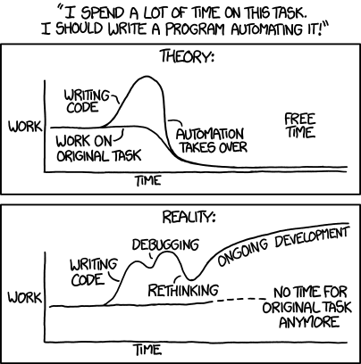
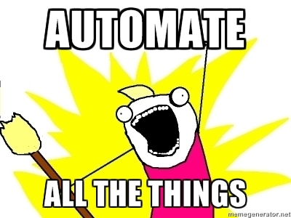
Watch out!!!
?

Slide 13


Questions

Slide 14
Thank you
Lech Lachowicz
Mail to: lech.Lachowicz@issa.com.pl

